Slide 1

Sales Performance Dashboard
BY : C T Thrisha

Slide 2

Driving Data-Driven Decisions
1
2
3
Monitor Performance
Analyze Trends
Inform Decisions
Track key metrics such as sales, profit, and growth to understand current business health.
Identify patterns and shifts across time, products, channels, and geographical markets.
Empower business stakeholders with insights for strategic planning and operational adjustments.

Slide 3

Dataset Overview: Foundation of Insights
Our interactive dashboard is built upon a comprehensive sales and financial dataset sourced from Kaggle. This robust dataset is meticulously structured to facilitate multi-dimensional business analysis, providing a rich foundation for actionable insights.
Date: Enables time-series analysis and trend identification.
Product Name: Allows for detailed product performance evaluation.
City: Supports geographic analysis and regional strategy development.
Channel: Facilitates channel efficiency and profitability assessment.
Sales: Core metric for revenue tracking.
Profit: Key indicator for financial health and viability.
Quantity Sold: Provides insights into product demand and volume.

Slide 4



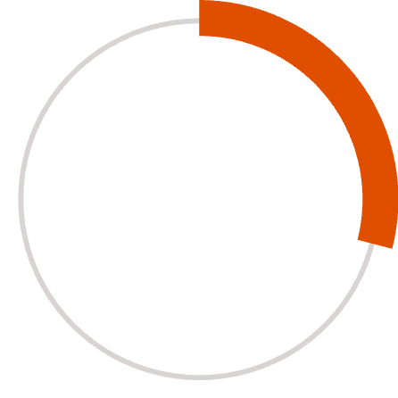

Key Performance Indicators (KPIs)
Providing an Instant Snapshot of Business Health
1.2M
Total Sales
Overall revenue generated across all products and channels.
350K
Total Profit
Net earnings after all expenses, indicating financial success.
29%
Profit Margin
Percentage of revenue that translates into profit, highlighting efficiency.
5.8K
Products Sold
Total units of products moved, reflecting market demand.

Slide 5


Enhancing Interaction: Dynamic Data Exploration
Our dashboard features intuitive slicers, allowing users to dynamically filter and analyze specific segments of data. This interactive capability transforms static reports into a powerful exploratory tool.
Date Range
Product Filtering
Analyze performance over custom periods, from daily to yearly views.
Isolate and examine individual product lines or categories.
City Selection
Channel Analysis
Drill down into sales data by specific geographic locations.
Compare performance across different sales channels like online, retail, or wholesale.

Slide 6
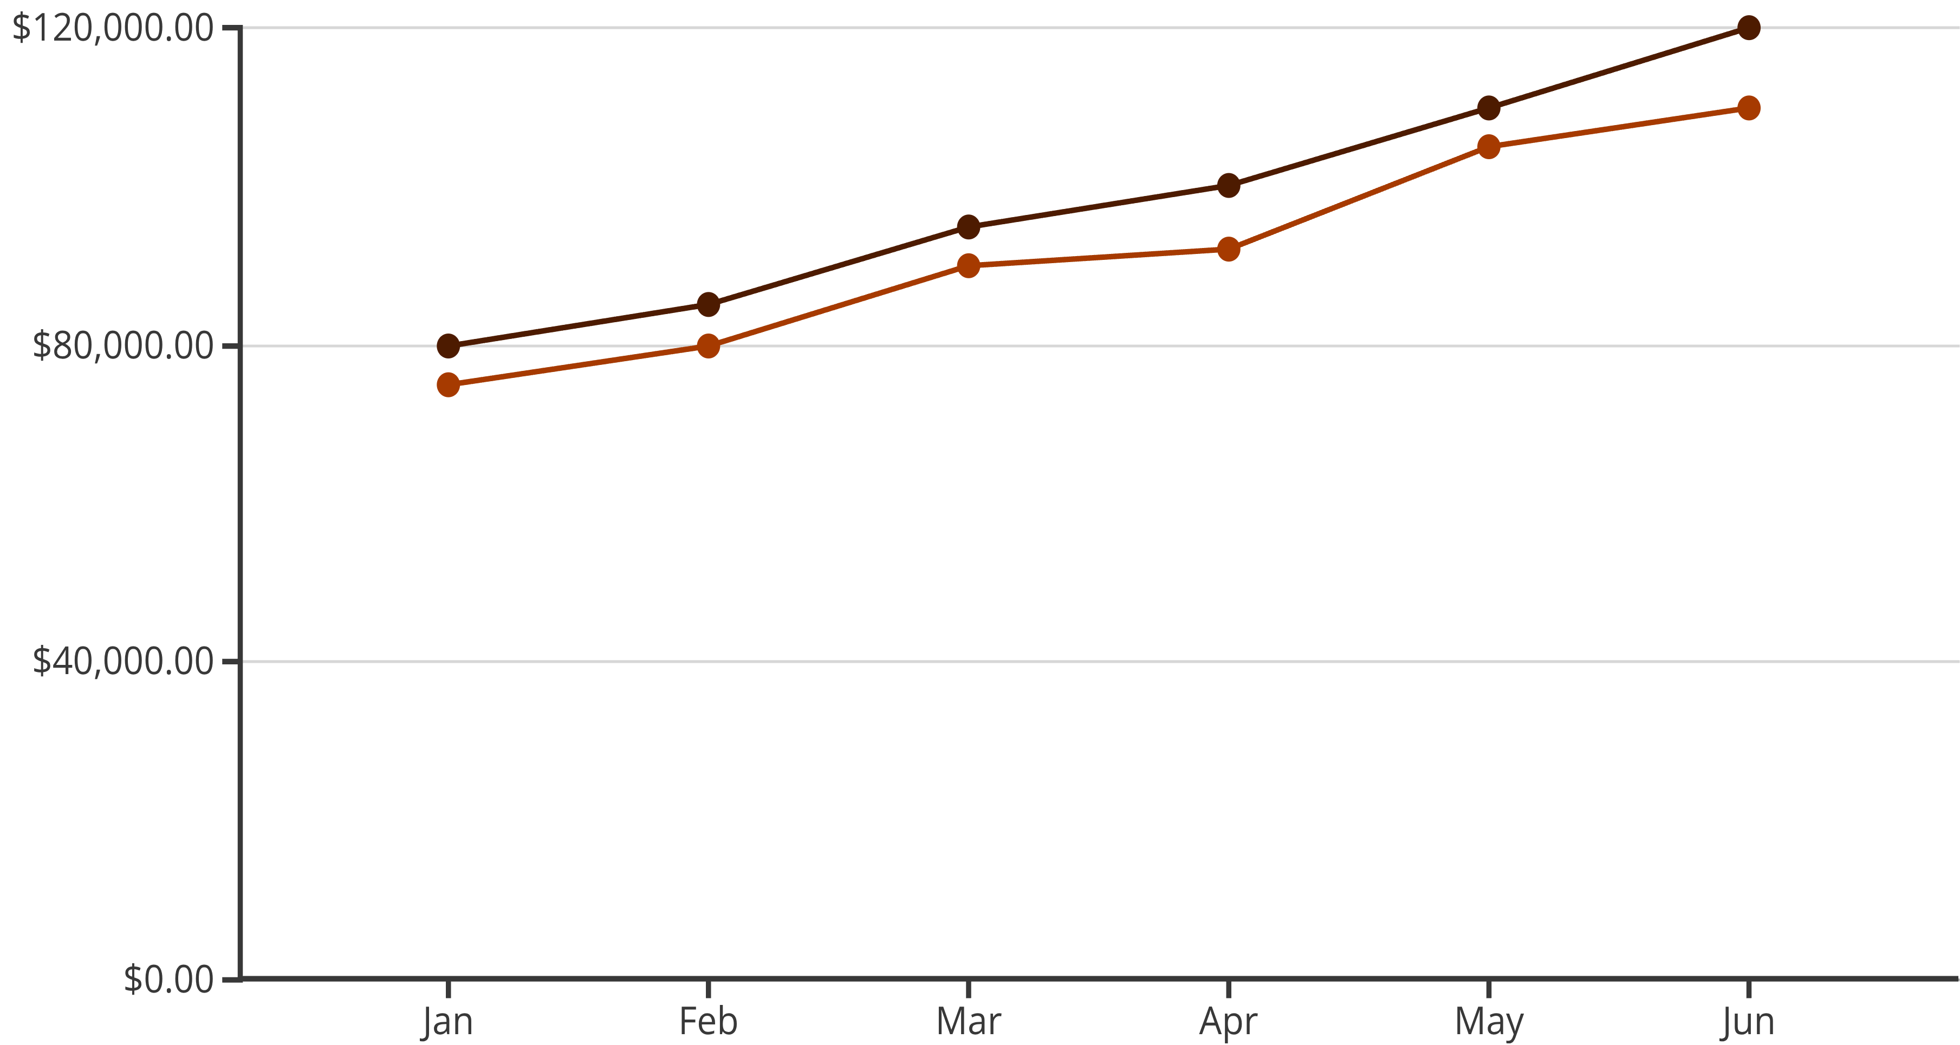
Time-Series Analysis: Uncovering Growth Patterns
A dedicated time-series visualization provides a comparative view of sales performance, contrasting Current Year (CY) against Previous Year (PY) data.
CY Sales
PY Sales
This analysis is crucial for:
Identifying sales trends and seasonal fluctuations.
Measuring growth over time and pinpointing areas of improvement.
Forecasting future sales and planning inventory more effectively.

Slide 7
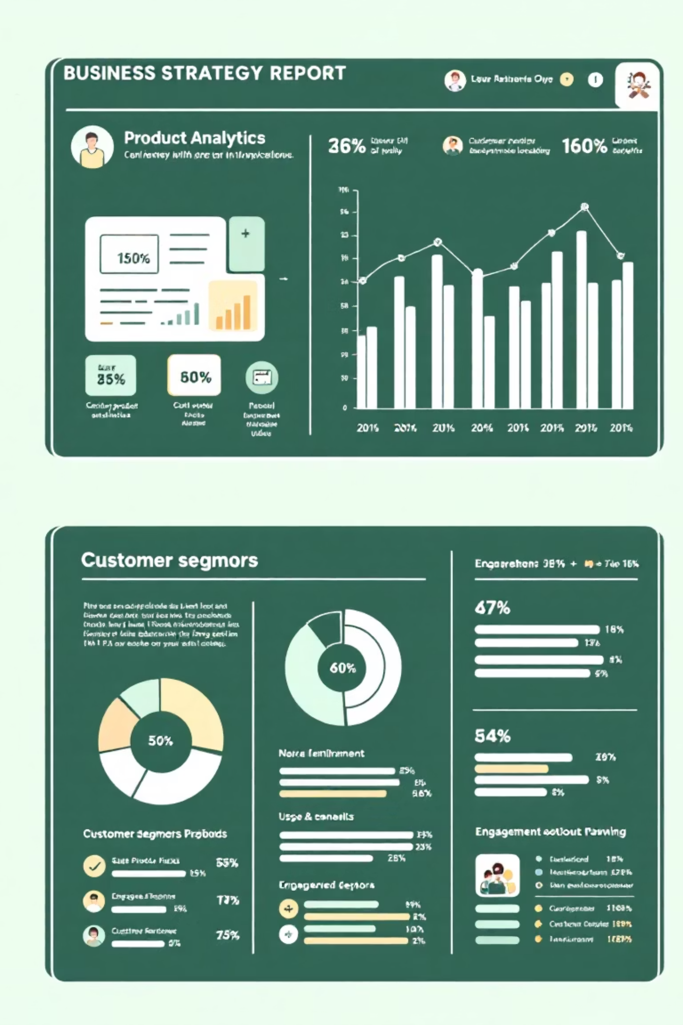
Optimizing Product & Customer Strategies
Understanding who buys what and how well products perform is key to strategic growth.
Product Performance
Detailed analysis reveals top-performing and underperforming products, guiding inventory, marketing, and development efforts.
Customer Insights
Identify key revenue-generating customers to tailor loyalty programs and personalized marketing campaigns, enhancing retention and lifetime value.

Slide 8
Channel Efficiency & Profitability
A deep dive into channel performance reveals profitability and efficiency across our diverse sales avenues.
25%
32%
18%
Wholesale Profit
Distributor Profit
Export Profit
Consistent profitability, driven by large volume transactions.
Highest profit margin, indicating strong partner relationships and market reach.
Growing segment with significant potential, requiring strategic investment.
This analysis enables us to:
Assess the contribution of each channel to overall profit.
Identify areas for optimization to improve channel efficiency.
Allocate resources strategically to maximize return on investment.

Slide 9
Geographic Analysis: Expanding Market Reach
Understanding sales distribution across different cities is vital for targeted regional planning and identifying new market expansion opportunities.
City D
1
New potential market, low sales contribution.
City C
2
Emerging market, steady growth.
City B
3
Strong performer, consistent sales.
City A
4
Top sales contributor, established market.
This city-wise analysis helps us to:
Identify high-performing regions for focused growth strategies.
Pinpoint underperforming areas that may require additional support or market penetration efforts.
Inform decisions on resource allocation, marketing campaigns, and logistical planning.

Slide 10

Conclusion: Empowering Strategic Growth
This interactive sales performance dashboard serves as a powerful tool, consolidating critical data into a user-friendly format.
Consolidated View
Provides a unified perspective on sales and profit performance across all dimensions.
Enhanced Usability
Interactive features ensure stakeholders can easily access and interpret relevant data.
Growth Identification
Highlights opportunities for expansion and pinpoints performance gaps requiring attention.
Data-Driven Decisions
Empowers organizations to make informed, effective business decisions based on real-time insights.
Leverage this dashboard to steer your business towards sustained success and optimized performance.

